Slide 1
CRYPTOLOGY from theory to practice
EMIL SIMION, Ph.D.
e-mail: esimion@fmi.unibuc.ro; esimion@upb.ro

Slide 2
AGENDA
I. Introduction to information security (models of security);
II. Cryptology: cryptography and cryptanalysis;
III. Course profile;
IV. References;
V. Examination.

Slide 3
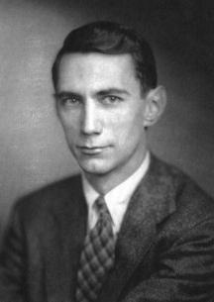
I. Shannon model for information transmission
Claude Elwood Shannon (April 30, 1916 – February 24, 2001) published, in 1949, Communication Theory of Secrecy Systems discussing cryptography from the viewpoint of information theory.

Slide 4
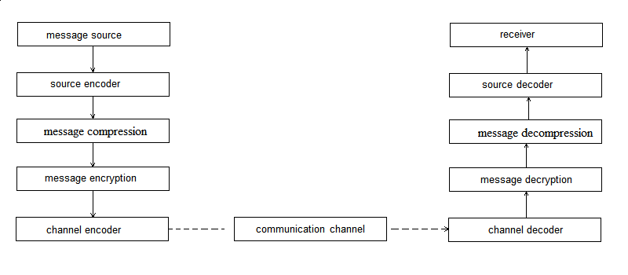
Shannon model for information transmission - cont

Slide 5
Information security attributes
Confidentiality;
Integrity;
Authenticity;
Non-repudiation;
Availability.

Slide 6
Model for security
Cryptographic algorithms are mathematical objects used in cryptographic modules (software, firmware and/or hardware) . These crypto-modules are used to design cryptographic products (applications and/or devices). The cryptographic products are used to protect data in communication systems or in specific applications.
Algorithm
Cryptographic Module
Product
Application / System

Slide 7
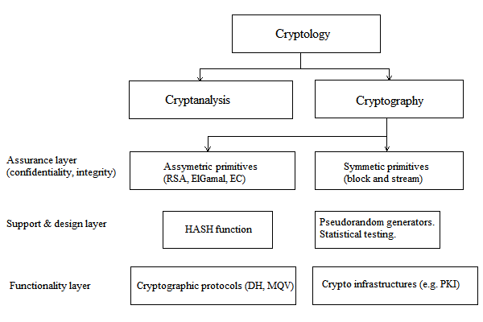
II. Cryptology

Slide 8
Some example: crypto algorithms
Cryptographic algorithms ensure: confidentiality and integrity (authentication, non repudiation and protection against errors) of the data;
Two type of algorithms: asymmetric (two different keys, one for encryption another for decryption, based on the computational difficulty of several problems: e.g. RSA [factoring], ElGamal [discreet log problem] and their extension to Elliptic curves) and symmetric (the same key used for encryption and decryption, e.g. AES).

Slide 9
Symmetric ciphers: block and stream
Block cipher
No internal state
Stream ciphers
Internal state
n
Message
Encrypted message
Logical
function
Additive stream cipher
((Pseudo)random key generator (P)RKG)
General stream cipher
Key
n
n
Encrypted message
memory
Plain message
+
+
Plain message
(P)RKG
(P)RKG

Slide 10
Asymmetric ciphers: example RSA
Open directory
USER A:
N_{a} = p_{a} . q_{a}
p_{a} . q_{a} tow secret large primes
φ(N_{a}) = (p_{a}-1).(q_{a} -1)
E_{a} = open key of A
D_{a} = E_{a}⁻¹ [mod φ(N_{a}) ]
USER B:
N_{b} = p_{b} . q_{b}
p_{b} . q_{b} tow secret large primes
φ(N_{b}) = (p_{b}-1).(q_{b} -1)
E_{b} = open key of B
D_{b} = E_{b}⁻¹ [mod φ(N_{b}) ]
A
N_{a}
E_{a}
B
N_{b}
E_{b}
.
A signs Document M to B:
D_{a}
(M,S)
E_{a}
D_{a} E_{a}
M = S (A signes M) S = M =M’ (Verify M’=M)
gcd (E_{a} , φ(N_{a}) ) = 1
gcd (E_{b} , φ(N_{b}) ) = 1

Slide 11
Practical example: Challenge-Response Identification Mechanism
Setup : Agree on a secret key K_{i}
and one-way function F
Prover A
Verifier
K_{i}
K_{i}
Rv
R_{t}
Who are you? : proof by using R_{v} that you know K_{i}
Generate random value R_{v}
(Challenge)
Auth request
RES=F(R_{t}, K_{i}, R_{v})
I am A, and this is the proof: RES, Rt
(Response)
?
If RES = F(K_{i}, R_{t}, R_{v})
then accept

Slide 12
Course profile
Classic ciphers: Cesar, substitutions, Playfair, Hill, polyalphabetic,transpositions, mixed systems;
Statistics: estimation and statistical tests;
Algebra: Computation in Galois field, Chinese Remainder Theorem etc.;
Pseudorandom generators;
Symmetric ciphers: AES candidate ciphers;
Asymmetric ciphers: Merkle-Hellmann, RSA, ElGamal, EC;
Cryptographic protocols: Diffie-Hellmann;
Cryptousage (PKI, e-mail security, IPSEC etc.);
Evaluation versus cracking.

Slide 13
References
J. Menezes and P. C. van Oorschot and S. A. Vanstone, Handbook of Applied Cryptography, CRC Press, fifth edition, ISBN 9780849385230, 2001.
B. Scheneier, Applied Cryptography: Protocols, Algorithms, and Source Code in C, John Wiley & Sons, Second Edition, ISBN 0-471-12845-7, 1996.
D. Naccache and E. Simion, Information security and Cryptology. Applications, MATRIX ROM, ISBN 978-973-755-675-2 , 2011.
D. Stinson, Cryptography Theory and Practice, CRC Press, Third edition, ISBN 9781584885085, 2005.

Slide 14
Examination
Homework project;
Application project you can work in a team of max. 4 members;
Seminar activity (bonus points);
Final test (with computers support): 2 hours.
Final mark: (H+A+F)/3 + S.
Proposals?

Slide 15
Thank you for your attention!

